Slide 1
Scripting your browser
with Selenium
Notes:
[Mandatory Slide] This would be the introduction slide of the topic that you are covering in this subsection.
When this slide plays, you could talk about the main aim that we’d be covering in this video.

Slide 2
In this Video, we are going to take a look at…
What is a web browser?
Setup Selenium
Code: emulate human interaction with a website
Notes:
[Mandatory Slide]
Before the start of the video, we’d like to highlight what are important topics or pointers that we’d be covering in this video. This slide would immediately follow the intro/name slide. This would just be say 2-3 points for the viewers to know what they are getting into.

Slide 3
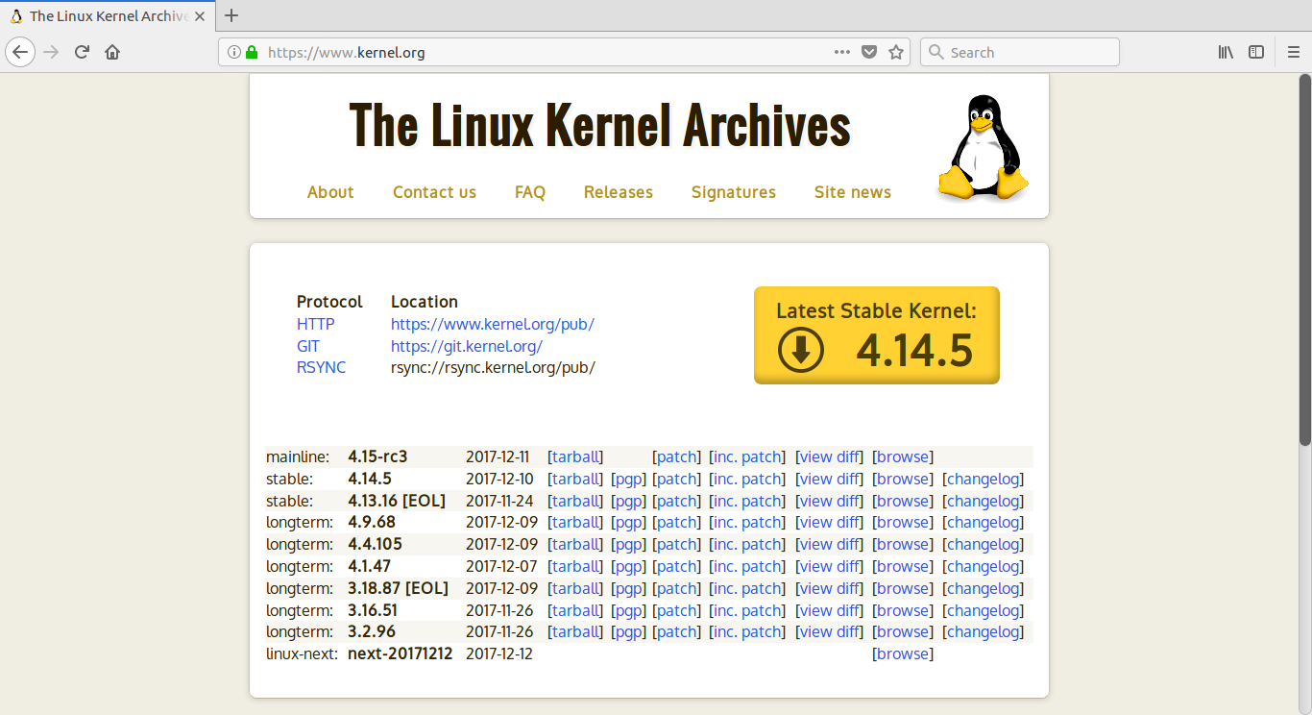
What is a web browser?
A web browser is the software that you probably use every day to display websites and search for information on the Internet
It is a tool for accessing, parsing and displaying web resources such as web pages and other media contents
Every modern browser has a Graphical User Interface (GUI) that renders HTML markup and allows us to read/input data from/to websites
Notes:
[Mandatory Slide]
Before the start of the video, we’d like to highlight what are important topics or pointers that we’d be covering in this video. This slide would immediately follow the intro/name slide. This would just be say 2-3 points for the viewers to know what they are getting into.

Slide 4
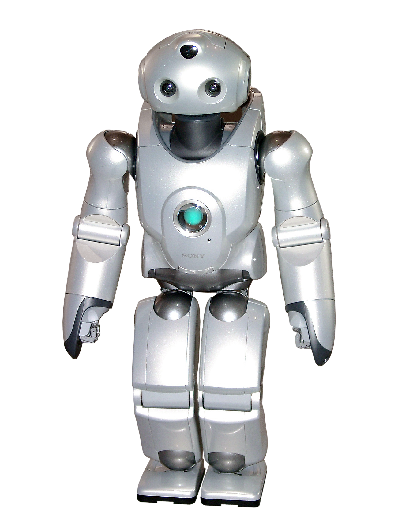
Setup Selenium
Selenium WebDriver is a tool that allows to automate browsers. Selenium emulates human interaction with the browser’s GUI
This means that you can use Selenium can to write automation scripts (eg. for testing purposes) that load pages, fill and submit forms, query on search engines, open menus, etc.
Before installing Selenium with pip install selenium you need to manually install the GeckoDriver dependency for it to work. Please refer to the GeckoDriver page for installation details (https://github.com/mozilla/geckodriver/releases)
Notes:
[Mandatory Slide]
Before the start of the video, we’d like to highlight what are important topics or pointers that we’d be covering in this video. This slide would immediately follow the intro/name slide. This would just be say 2-3 points for the viewers to know what they are getting into.

Slide 5
Code: emulate human interaction with a website
Notes:
Something that needs to grab the viewers attention!!

Slide 6
Summary
What is a web browser?
Setup Selenium
Code: emulate human interaction with a website
Notes:
[Mandatory Slide]
Before the start of the video, we’d like to highlight what are important topics or pointers that we’d be covering in this video. This slide would immediately follow the intro/name slide. This would just be say 2-3 points for the viewers to know what they are getting into.

Slide 7
The power of APIs
Next Section
Notes:
[Mandatory Slide]
Here the name of the next section needs to be mentioned. The narration as you guessed it would be just letting the viewer know what we’d be taking over next! ☺

